Slide 1
6 Month Committee Meeting
5/28/2020
April Peterson
Payseur Lab
Notes:
-review main results from 2nd chapter
-present chapter 3 proposal
-timeline
Remember that for your committee meeting it will be important to motivate the work by identifying the main questions and describing the bigger picture.

Slide 2
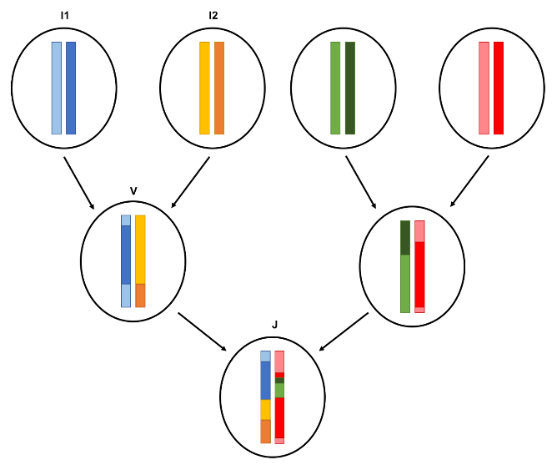
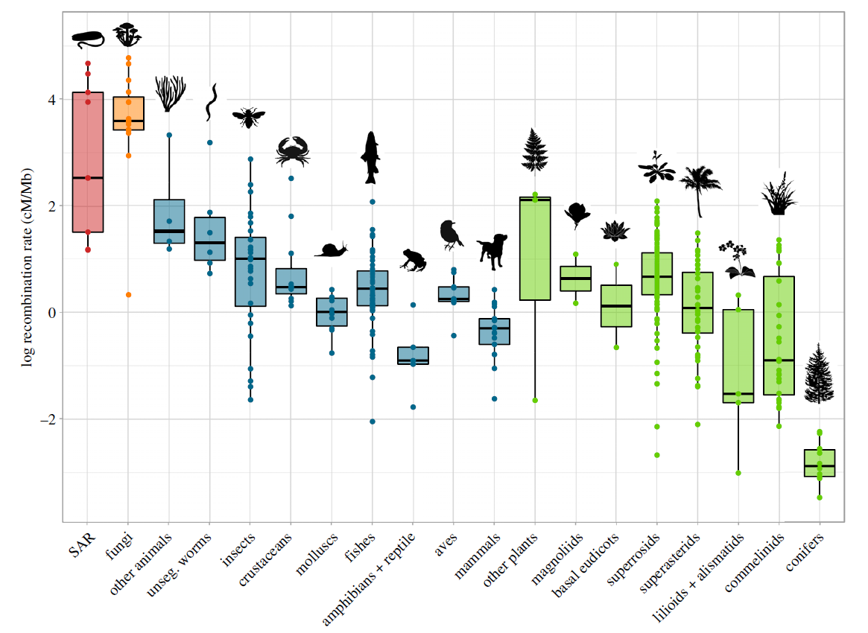
Importance of meiotic recombination
MR – help or hinder selection
Major source of genetic variation
https://www.mv.helsinki.fi/home/mjxpirin/stamp/stamp.html
Gruhn, Jennifer R., et al. PloS one 8.12 (2013).
Stapley et. al 2017
Indirect selection
Creation of genetic variation
Notes:
(consequences and purposes of crossovers:
(range of variation)
(motivation for examining this trait)
( recombination rate can aid or hinder selection on traits / evolution
( it can mix two populations’ genetics or keep them distinct)
The main product of meiotic recombination are crossovers which are formed when two chromosomes physically exchange material. Before the crossover is fully resolve and the two chromosome strands pulled apart, a tension force is created across the spindle of the dividing cell. This tension force is important for ensuring that the right number of chromosomes end up in the cells from the final meiotic division. Too many or too few crossovers can disrupt this tension force and cause aneuploidy.
This can affect an individual’s fitness through their number of germ cells or viable zygotes. This functional effect of crossovers stabilizing homologous during the first cell division of meiosis exerts a direct selection on recombination rate
Another product of crossovers – are recombinant chromosomes, these new versions of chromosomes which are different from the parental versions. If we use this example of diploids with a genome of 1 chromosome, the genome wide recombination rate is the number of crossovers that occur over a genetic distance per meiosis. The recombination rate across all chromosomes per meiosis, is the genome-wide recombination rate (and that will be the measure I am focusing on today).
The recombination rate is an important parameter for predicting how often deleterious alleles are separated from good alleles, or good alleles separated from each other. Meiotic recombination can affect how a population responds to selection and how the patterns of genetic variation are generated.
These aspects have an indirect effect on recombination, since the fitness consequences of an individuals recombination rate are only realized through the surviving descendants.
Recombination rates vary several fold across taxa and closely related species.
This figure from a recent review shows the large amount of diversity in gwRR across microbes, animals, and plants. This comparison of recombination rates across a broad diversity of life reveals general patterns and maybe some interesting exceptions,
But the variation presented in this figure mostly comes from a few representatives of each species, so it isn’t that useful for questions about recombination rate variation that rely on comparing indiviuals.

Slide 3
Major Questions: What are the evolutionary patterns of genome wide recombination rates (gwRR) variation at short time scales?
How do meiotic traits vary with genome wide recombination rate?
How do individuals vary from each other, due to sex, genetics, or environment?
Aim 1: How much do individuals from a natural population vary in their recombination rates?
Aim 2: How does genome wide recombination rate and related meiotic traits vary due to sex in the house mouse?
Aim 3: How do these patterns vary between cells within an individual?
Notes:
Provide interesting / compelling questions for my 3 aims
(I will only talk about aims 1 and 2)
Main questions for my thesis research
The major questions of my research are how recombination rates evolve and how factors of gametogenesis might be shaping the evolution of recombination rates in each sex. These are large complicated questions which needs to be broken down into smaller questions.
Today – I’ll review some of Chapter 2
But mostly focus on Chapter 3

Slide 4
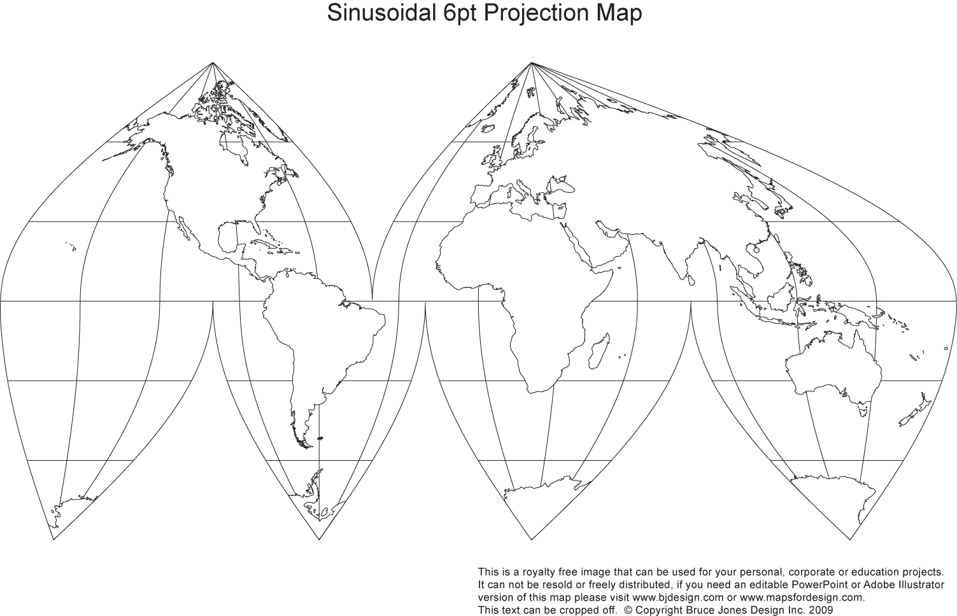
M. m. domesticus
WSB
LEWES
PERC
Gough
M. m. musculus
PWD
CZECH II
SKIVE
KAZ
TOM
M. m. castaneus
CAST
HMI
M. m. molossinus
MSM
MOLF
Mus musculus
Origin
Outgroups
Mus spretus (~3 mya)
Mus spicilegus (~3 mya)
Mus caroli (~5 mya)
Staining Approach
-Individual genome wide recombination rates (gwRRs)
- Meiotic chromosome behavior
Notes:
Brief background of the approach for these two chapters I’ll be covering
The house mouse is a good model to use for tackling evolutionary questions given it’s global distribution an radiation
(example of sampling of (available house mouse strains ))
House mouse is a good sample <<bc it allows us to sample and better understand natural variation (in the recombination rate phenotype) /// (that can allow us to model evolutionary patterns for this trait// by quantifing within the species and related murine species as outgroups.
<<develop wild inbred strains, and bring them into a common lab environment and <normalize> the genetic background between females and males.
The house mouse species complex has 3 major subspecies which recently radiated 350-500kya; Domesticus, musculus, and castaneus.

Slide 5
Chapter 2, Sex-Specific Evolution of the Meiotic Recombination Rate
How does heterochiasmy evolve over short time scales?
What other meiotic traits correlate with heterochiasmy?
-Rapid male-specific evolution in 3 strains; musculus^{PWD}, musculus^{SKIVE}, and molossinus^{MSM}. Enrichment of double crossovers (2CO) over single crossover chrms (1CO).
-Evolution more double strand break (DSBs) in musculus^{PWD} and molossinus^{MSM} in early zygotene cells.
- Conserved sexually dimorphic traits:
1) Greater between cell variation in females, 2) Longer SC axis in females and 3) Foci positioning differences
-Significantly stronger interference, via 2CO InterFocal Distance (IFD), observed in high recombining males.
Notes:
Two of the driving questions for this chapter were
X
X
Main results:
3 strains had rapid evolution in male specific gwRR
Unexpected relationship with IFD and gwRR
- IFD triangle plots + terminal positions) (does the position of CO affect the IFD) (make these plots)
Broad patterns / interpertations
- Distinct evolutionary trajectories
Conserved sex differences in gwRR and related traits

Slide 6
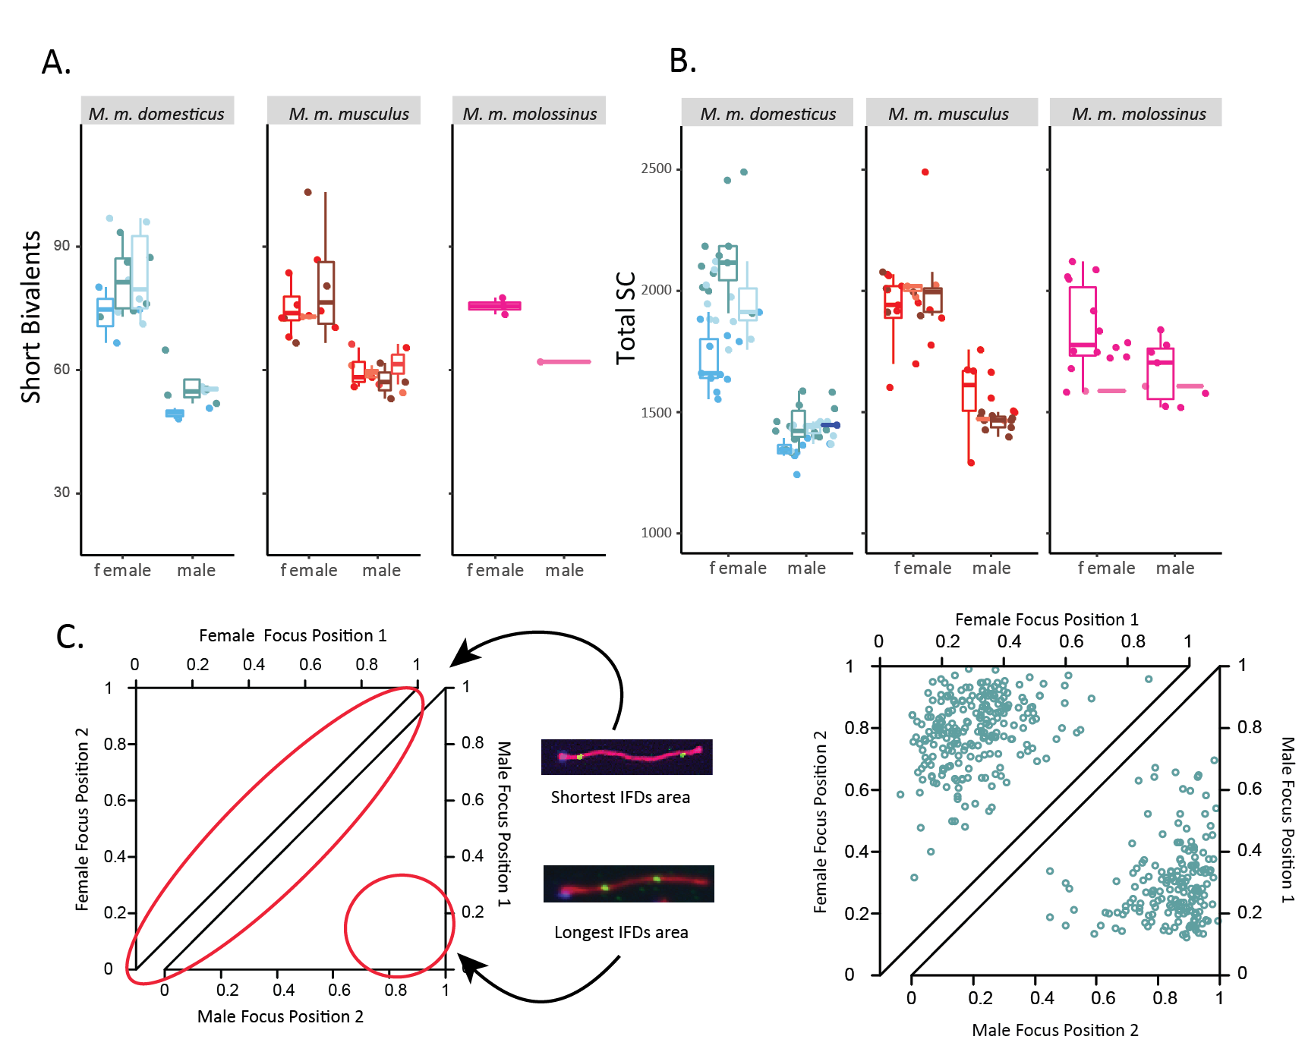
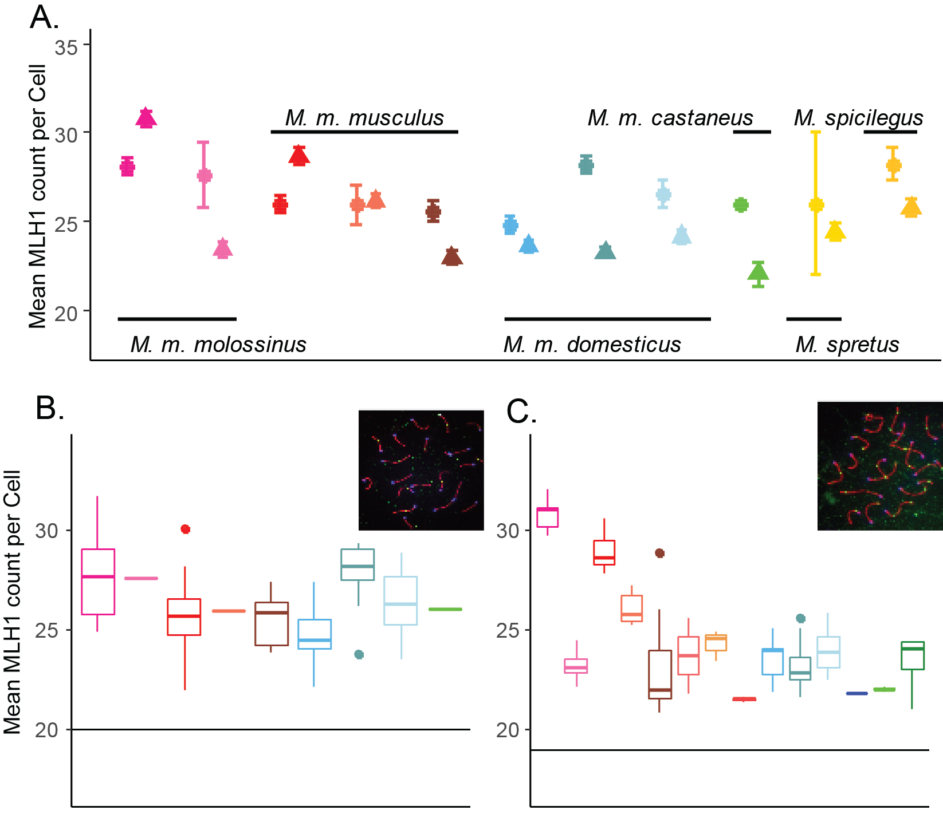
Chapter 2, Main results
SC
Total SC
Female gwRR
Male gwRR
2CO
Interference
Notes:
2COs
General IFD patterns of sexual dimorphism
(compare IFD irrespective of SC length)
Males have smaller range of IFDs
Females have closer pairs of foci located on more parts of a bivalent
Males foci pairs are a longer distance apart and the second foci is anchored closer to the telomere

Slide 7
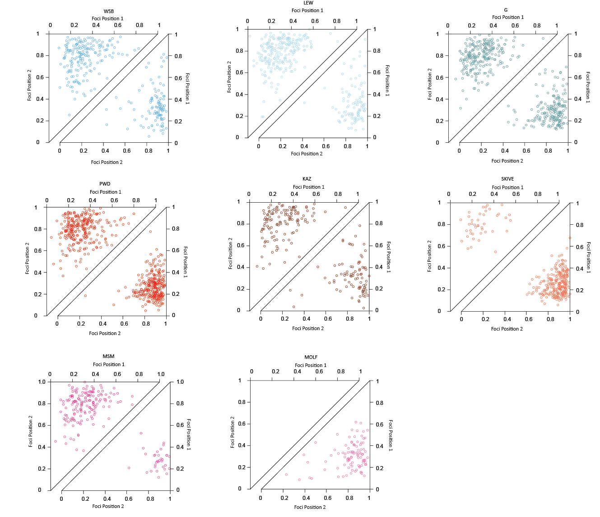

Slide 8
Distinct evolutionary trajectories
Genome wide recombination rates
Female Recombination Rate (cM)
M.m.
domesticus
M.m.
musculus
Mammals
Data from Lenormand and Duthiel, 2005 and Brandvain and Coop 2012.
Male Recombination Rate (cM)
Notes:
(background on patterns of heterochiasmy
(motivation for using the house mouse (rodent) taxa to examine these patterns)
(house mouse pattern driven by male specific rapid evolution)
The differences in the pattern of variation within and across subspecies is evidence that male and female rates can evolve independently to a given degree.
(suggest different selective or evolutionary forces)

Slide 9
Distinct evolutionary trajectories
Genome wide recombination rates
Mammals
Female Recombination Rate (cM)
M.m.
molossinus
M.m.
domesticus
M.m.
musculus
Data from Lenormand and Duthiel, 2005 and Brandvain and Coop 2012.
Male Recombination Rate (cM)
Notes:
Sex is crucial factor when considering variation in recombination rates. My results emphasize that the genome wide recombination rates experience distinct evolutionary trajectories.
<explain plot>

Slide 10
Interpretation
Fitting to hypothesis (popgen and functional – cell based)
1) -conserved sex-dimorphic traits and 2) correlation of RR evolution and stronger interference
Evolution patterns – distinct by sex
Notes:
Sex is crucial factor when considering variation in recombination rates. My results emphasize that the genome wide recombination rates experience distinct evolutionary trajectories.

Slide 11
Model | Reverse heterochiasmy direction Male > Female gwRR | Within mouse variance for CO number Eggs more variable than sperm in crossover per cell | Broad Scale Recombination Landscape Male telomere bias, Female uniform placement | Chromatin Compaction Female, longer axis Male, shorter axis | Evolution of positive correlation interference strength and CO number
Haploid selection (Lenormand, 2003; Lenormand and Dutheil, 2005) | No Generally males should evolve lower gwRR. | NA | NA No prediction for broad scale recombination landscape. | NA No prediction for chromosome axis. | NA
Two locus modifier (Brandvain and Coop, 2012) | Yes Depends on if rec. modifier: i) suppresses or increases recombination, ii) linked to driving loci, iii) the stage in which the driver acts (MI or MII) | NA | Yes Females will evolve higher RR and COs closer to centromeres to break up MI drive systems. | NA No prediction for chromosome axis. | NA
S.A.C.E. (Sardell and Kirkpatrick, 2020) | No Males should evolve to be lower gwRR. | Yes Maintaining regulatory and coding regions together lowers between cell variance in males. | Yes Maintaining larger blocks of chromosomes positions crossovers to telomeres. | NA No prediction for chromosome axis. | Yes Stronger interference is equivalent to larger blocks of chromosomes segregation together.
MI Spindle based selection (Altendorfer et al., 2020; Dernburg, 2001; Lee, 2019; van Veen and Hawley, 2003) | Yes More effective checkpoint (SAC) will cause faster evolution in males relative to females. | Yes Relaxed selection on SAC would increases variance across oocytes relative to spermatocytes. | Yes Telomere position of single crossover chromosomes maximizes sister cohesion with tension and may synchronize division of bivalents. | NA No prediction for chromosome axis. | Yes Amount of sister cohesion could: i) stabilize bivalents and allow SAC to detect tension or ii) regulate the timing of entry into anaphase via modulating the rate of degradation of the sister cohesion.
Pairing based selection, C.O.M. (Hultén, 2011) | NA No evolution predictions. | NA No prediction for between gamete variance. | Yes Difference of interference in sexes is due to axis length differences. | Yes Longer female axis driven by larger cell volume. | No No prediction for reduction phase.
Notes:
Table X. Comparison of results from to models of heterochiasmy and recombination rate evolution.
References:
Altendorfer, E., Láscarez-Lagunas, L.I., Nadarajan, S., Mathieson, I., and Colaiácovo, M.P. (2020). Crossover Position Drives Chromosome Remodeling for Accurate Meiotic Chromosome Segregation. Curr. Biol.
Brandvain, Y., and Coop, G. (2012). Scrambling eggs: meiotic drive and the evolution of female recombination rates. Genetics 190, 709–723.
Dernburg, A.F. (2001). Here, there, and everywhere: kinetochore function on holocentric chromosomes. J. Cell Biol. 153, F33–F38.
Hultén, M.A. (2011). On the origin of crossover interference: A chromosome oscillatory movement (COM) model. Mol. Cytogenet. 4, 10.
Lee, J. (2019). Is age-related increase of chromosome segregation errors in mammalian oocytes caused by cohesin deterioration? Reprod. Med. Biol.
Lenormand, T. (2003). The evolution of sex dimorphism in recombination. Genetics 163, 811–822.
Lenormand, T., and Dutheil, J. (2005). Recombination difference between sexes: a role for haploid selection. PLoS Biol. 3, e63.
Sardell, J.M., and Kirkpatrick, M. (2020). Sex Differences in the Recombination Landscape. Am. Nat. 195, 361–379.
van Veen, J.E., and Hawley, R.S. (2003). Meiosis: when even two is a crowd. Curr. Biol. 13, R831–R833.

Slide 12
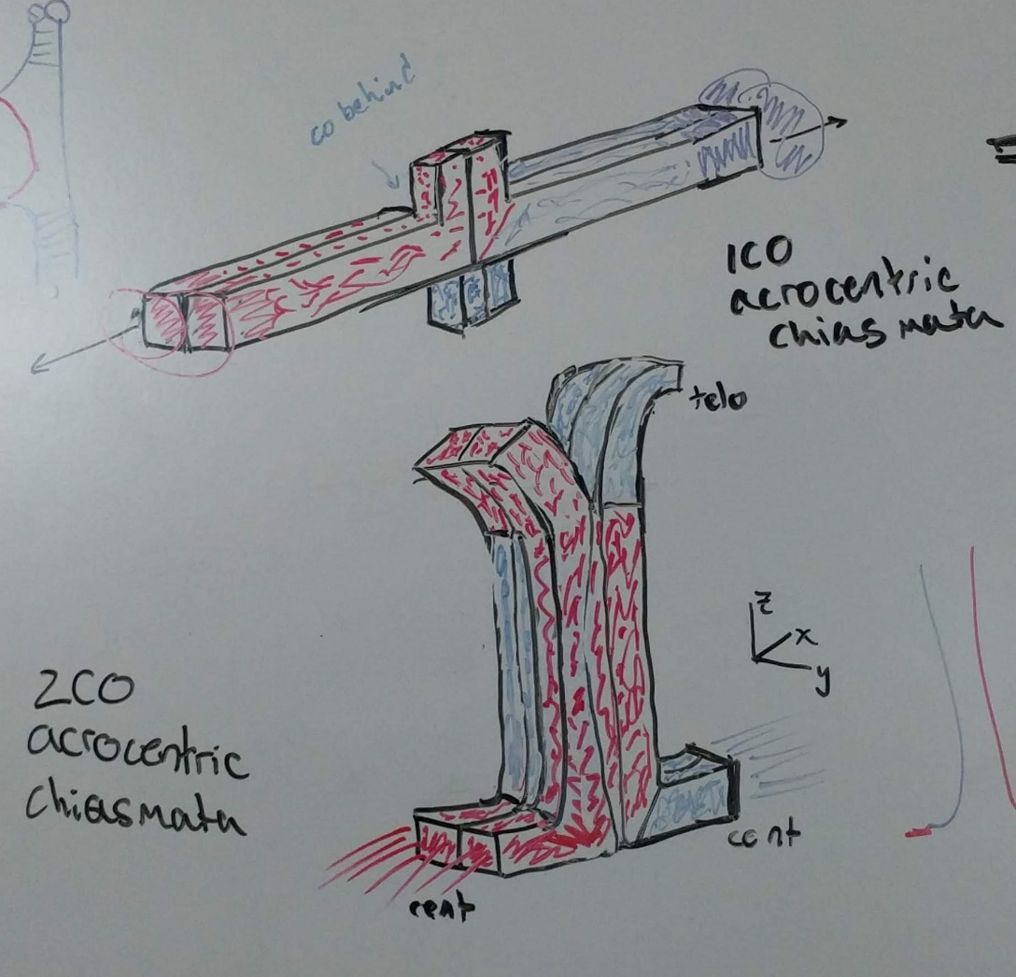
MI Spindle based selection model
Sister-cohesion distal to chiasmata
The number and position of crossovers affects the amount sister cohesion with tension at metaphase I
Kinetochores
1CO chromosome
2CO chromosome

Slide 13
Chapter 3, Crossover count per cell is more variable in females
Motivation and Background:
Overdispersal of CO counts per cell is common
Sex difference are mostly from female-biased species, (humans and mice)
Variance of a trait can shape selection
Affect on rates of aneuploidy
What are the patterns of within individual variation in CO count?
Human
Has between cell variance in CO count evolved in house mice?
Gruhn, Jennifer R., et al. PloS one 8.12 (2013).
Notes:
Motivation for Chapter 3
Between cell variance (individual level variance)

Slide 14
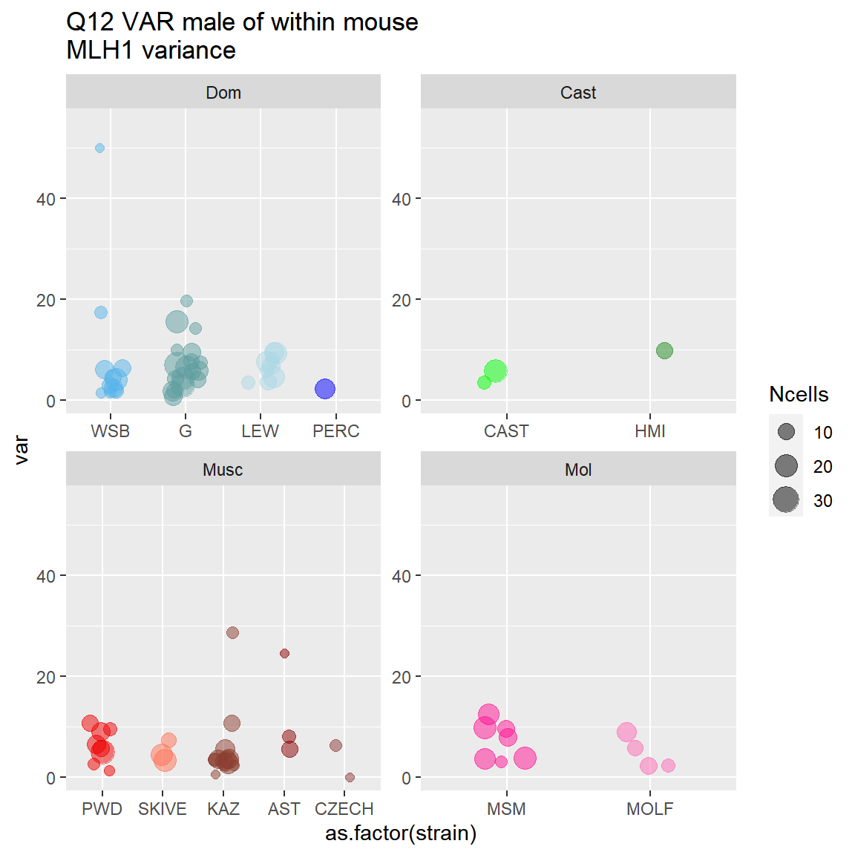
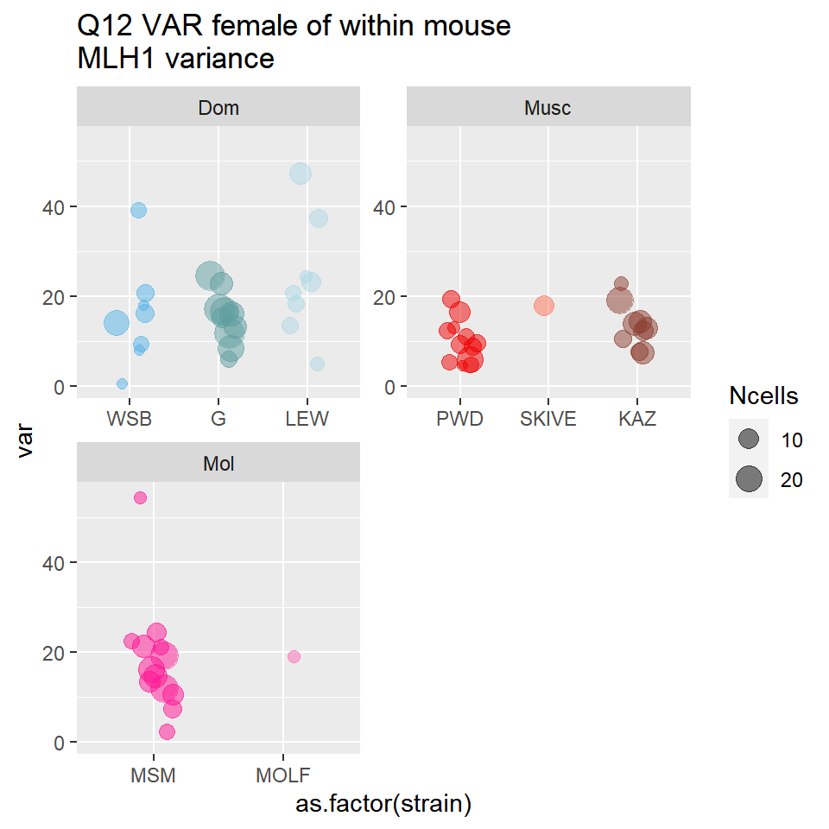
Chapter 3, Preliminary Results
Variance per Mouse
Variance per Mouse
Notes:
“Sex differences in between cell variation for crossover count”
(approach + preliminary results)
Build / use data from Chapter 2
Results – all this anaylsis is based on chapter 2 results – follows up on some of those findings
This plot shows the mouse level variance, (for the highest
Approach / methods
MLH1 house mouse data from Chapter 2
Use higher quality cells
Analetical framework
Glm models
Permutations for
-1. Sets of glms Models from chapter two, (mouse level variance for MLH1)
Sex only significant effect – (these are only slightly significant)
2. Permutation of Variance across strains
(pool all cells, within sex,
The observed sex-specific variance across strains, are not significant

Slide 15
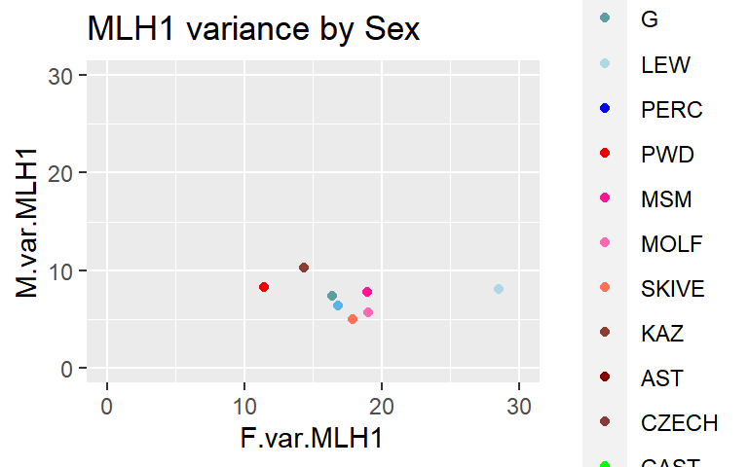
Chapter 3, Preliminary Results
Strain Variance
Male
Strain Variance
Female

Slide 16
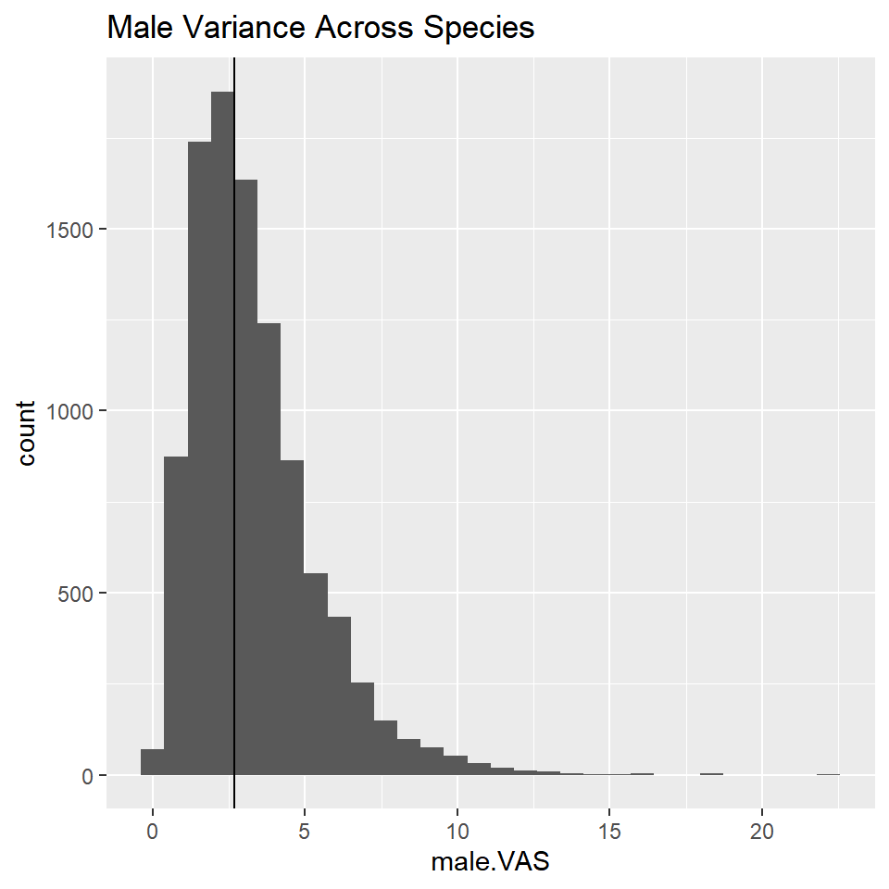
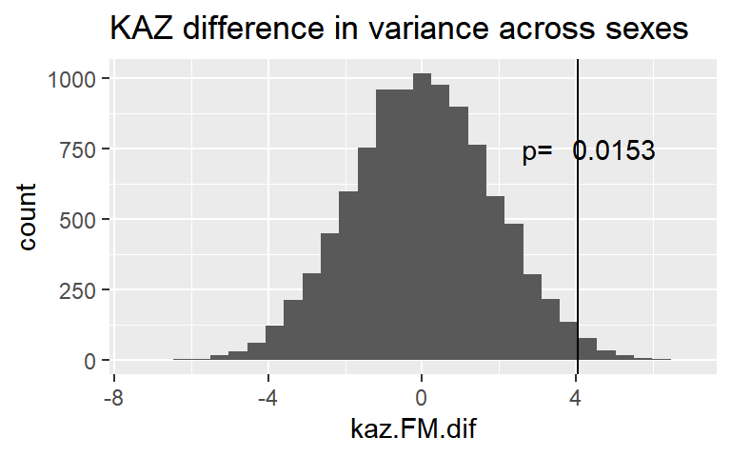
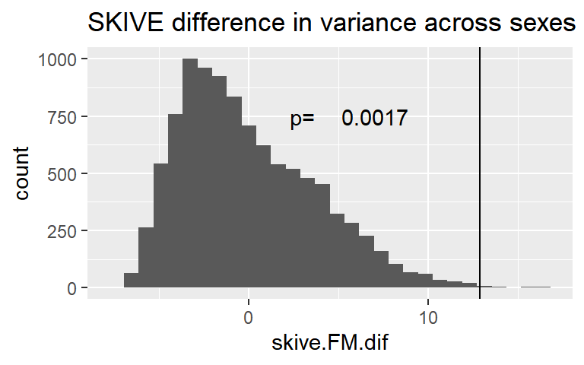
Chapter 3, Preliminary Results Permutations
Male variance across strains
n=10,000
p= 0.46
Permutation set 2, Sex difference in variance within strains
Pool all cells within a strain, randomize sex
Calculate Female.var - male.var difference
All observed sex differences are significant compared to permutations
Permutation set 1, Variance across strains
Pool all cells within sex, randomize strain for the same number of MLH1 counts
Calculate the variance across ‘strains’
No evidence of strain effects for the observed variance across cells
Notes:
Models
Permutations 1
Permutations 2
SC comparison –
My interpretation for these SC variance are that there's weak evidence of sex effect and no evidence of direct connection to MLH1 variance. Glm models indicate that SC.var and MLH1.var both have a conserved sex effect. From the direct tests section, there's no evidence of causation, SC.var -> MLH1.var,
My interpretation for the weak association between MLH1 mean and variance indicates that the meiotic 'regulation' for COs per cell is conserved across strains and inherently different between sexes.

Slide 17
MLH1 variance
Number of cells per mouse (Q12)
Distributions of MLH1 variance, (females have bigger range and the mean is shifted up compared to males
Correlation of mean and variance is pretty weak – stronger in females, (but significant). (because females have larger range for variance and lower range of MLH1 mean. Pval of cor not significant for males. Between cell variance not influenced by mean in males, (mean and variance cor, indicate something about cv?)
Models (for testing significance of coefficients), sex is most significant in the mixed model – the rest of the glms – sex effect is only slightly significant. None of the sex specific subsp or strain effects were significant (same in var as cV)
Permutations – The variance of var(mouse) was compared. – The observed value has potnential influence forom strains, the permutations don’t sense all cells are pooled. The observed VAS is not significantly different from randomized permutations. – there’s no evidence of subspecies - strain effects. Sex effect on between cell variance is conserved, (female’s have greater between cell variance for CO count compared to males)

Slide 18
Total SC
Total SC variance (numbers), I’d say decent numbers of mice and cells for limiting to Q12.
Plots, the var(skel) in females is higher (a PWD and G male has a female level)
Correlation of mean and variance – only males are slightly significant, variance in the skel is also low for males – where females have greater range of values. The correlations are very weak for both, the ranges of variance show sex differences.
Models, mixed model sex most significant, around 0.5 for the other models (didn’t calq cV for this table). (Basically the same as mlh1 var)
Direct tests – (add sex – specific) – the effects changed when I added interaction effect, sex no longer as significant for all the models – except the MLH1.var ~ SC.var * sex (sex is significant (this indicates SC.var is bad at predicting mlh1.var (but also I worry that this just shows lower power).
Notes:
The total –SC could get more cells than the Q12 MLH1 cells – since I was a little biased is applying that score for MLH1 staining. But while imaging – I saw enough cells with no MLH1 but great SC,
But issue is that I haven’t confirmed that the algorithm output is good across all of the cells
-- there could be an issue with the new laser too.

Slide 19
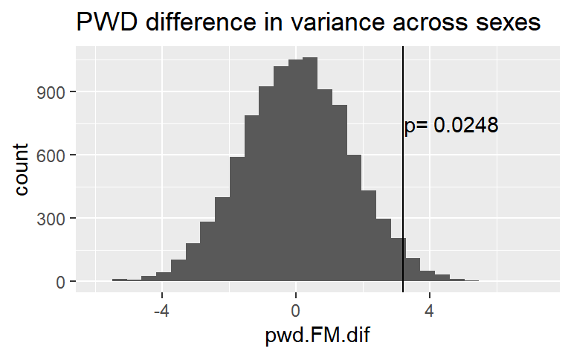
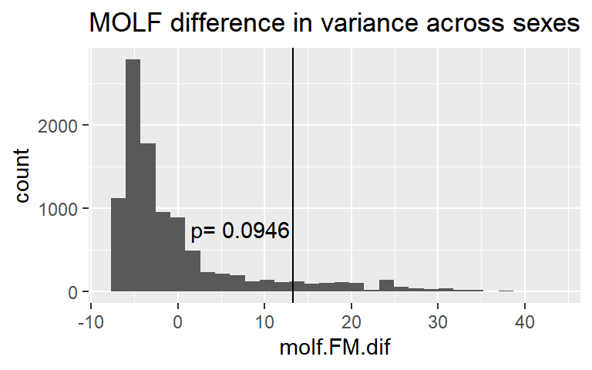
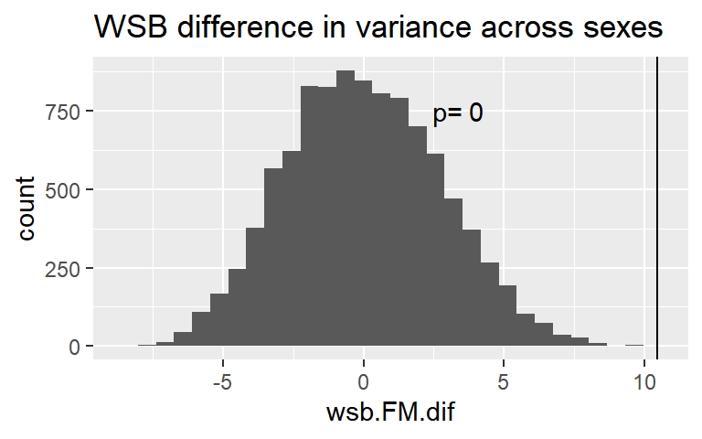
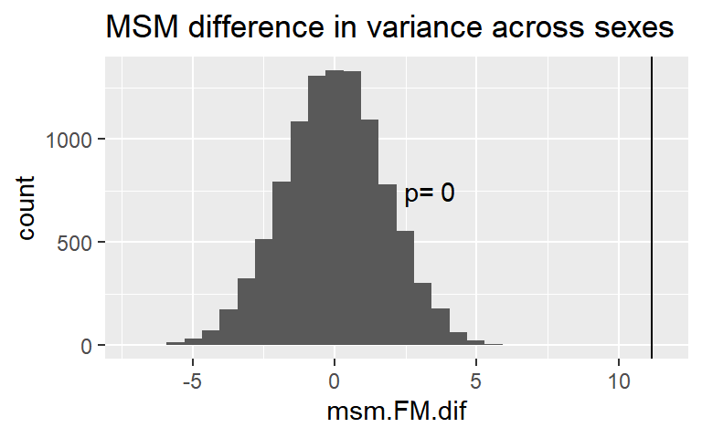
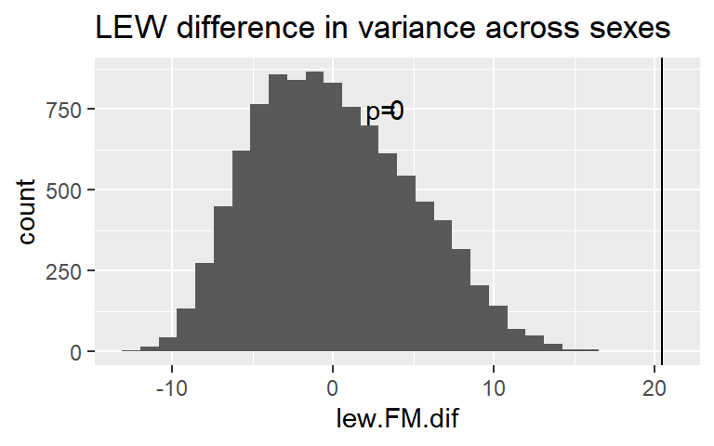
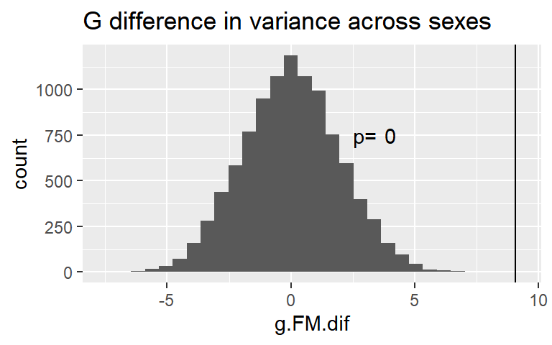

Slide 20
(current interpretations)
My interpretation for the weak association between MLH1 mean and variance indicates that the meiotic 'regulation' for COs per cell is conserved across strains and inherently different between sexes.
1. What these results tell us about the mechanism
-timing of MLH1 (life-span of observed foci)
-(selection strength against (minium CO per chrm) is different in oogenesis and spermatogenesis
Type II COs, alternative segregation mechanisms or annueploidy correction
2. what these results tell us about (evolution) mechanism
Notes:
My interpretation for the weak association between MLH1 mean and variance indicates that the meiotic 'regulation' for COs per cell is conserved across strains and inherently different between sexes.
Bigger picture
-is the different regulation due to functional features of meiosis Or driven by indirect selection ?
-what does this mean for evolution of RR?
(meets my expectations)
1.slower evolution of gwRR in females compared to males
2.

Slide 21
Chapter 3, Crossover count per cell is more variable in females
My interpretation for the weak association between MLH1 mean and variance indicates that the meiotic 'regulation' for COs per cell is conserved across strains and inherently different between sexes.
1. What these results tell us about the mechanism
-timing of MLH1 (life-span of observed foci)
-(selection strength against (minium CO per chrm) is different in oogenesis and spermatogenesis
Type II COs, alternative segregation mechanisms or annueploidy correction
2. what these results tell us about (evolution) mechanism
Big picture for mechanism (acentriole spindle)
Notes:
My interpretation for the weak association between MLH1 mean and variance indicates that the meiotic 'regulation' for COs per cell is conserved across strains and inherently different between sexes.
Bigger picture
-is the different regulation due to functional features of meiosis Or driven by indirect selection ?
-what does this mean for evolution of RR?
(meets my expectations)
1.slower evolution of gwRR in females compared to males
2.

Slide 22
Concerns / caveats
-sample sizes
-outliers (cells, mice)
-jack-knife permutations
-track mice in Q12 and full dataset
-SC connection / SC data (total SC
Stick to broad general patterns
SC connection
Veller etal 2018
Overdispersal of CO-variance across cells
Is facilitated via the SC / axis length

Slide 23
Defense Timeline
June
Submit Chapter 2
Finish up analysis for Chapter 3
July
Write and submit manuscript for Chapter 3
August-September
Write draft for thesis Intro and Discussion
October 2020
Final edits to thesis and defense
Notes:
Previously set an aggressive timeline for defending by the end of summer term. I recognize now that might not be achieveable. I’ve updated to a defense date that might be more reasonable.

Slide 25
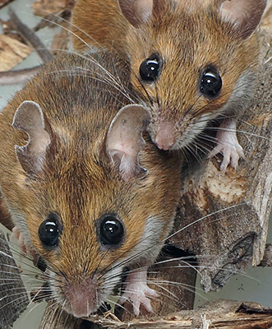
Conservation of the genome-wide recombination rate in white-footed mice
- Estimates of genome-wide recombination rates (gwRRs) from mice in a natural population -- compared to lab raised mice
- no evidence of difference between wild and lab raised gwRRs
-Fits a model of stabilizing selection acting on the male-specific gwRR.
(other estimates of gwRR from natural populations)
-D.psudobscura (directional / adaptation)
-Soay Sheep (Heterochiasmy / male-biased?)
-Red Deer (?)
Dr. Gabor Szalai and Janet Crossland,
Peromyscus Stock Center
Notes:
My first chapter was published last year
I’ll just give the brief highlights
-I quantified the genome wide recombination rates of wild caught and lab raise Peromycus leucopus and lab raised Peromyscus maniculatus baridii
-all mouse gwRR were all very close to the expected minimum of 1 CO per chrm
-While some mice varied significantly from each other, the groups of wild and lab raised mice did not show a significant difference in gwRRs.
We interpreted these results as support for stabilizing selection acting on the male gwRR in this natural population.
-joins other estimates gwRR for natural populations
Samuk – Dspudo, Jonston Soay sheep
-- lays the base for understanding the evolution of this important trait in nature.

Slide 26
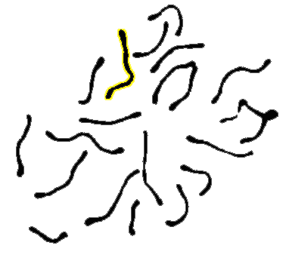
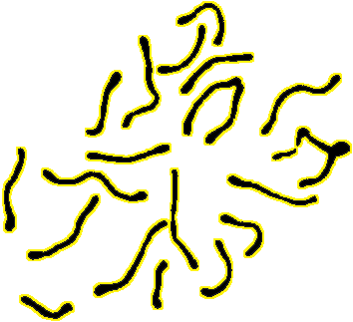
SC data

Slide 27
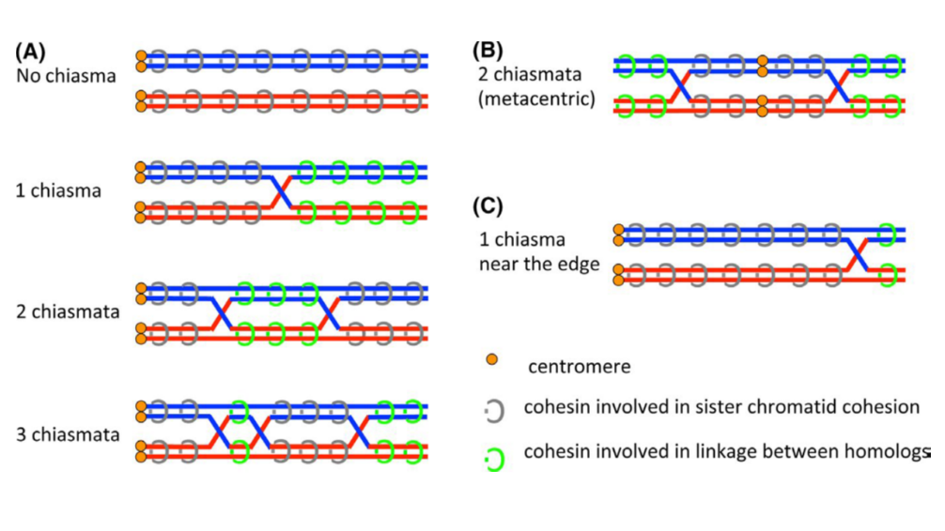
MI Spindle based selection model
Sister-cohesion distal to chiasmata
The number and position of crossovers (chiasmata) effect the amount sister cohesion with tension at metaphase I
Kinetochores
1CO chromosome
2CO chromosome
Lee, J. (2020). Reproductive Medicine and Biology, 19(1), 32-41.

Slide 28
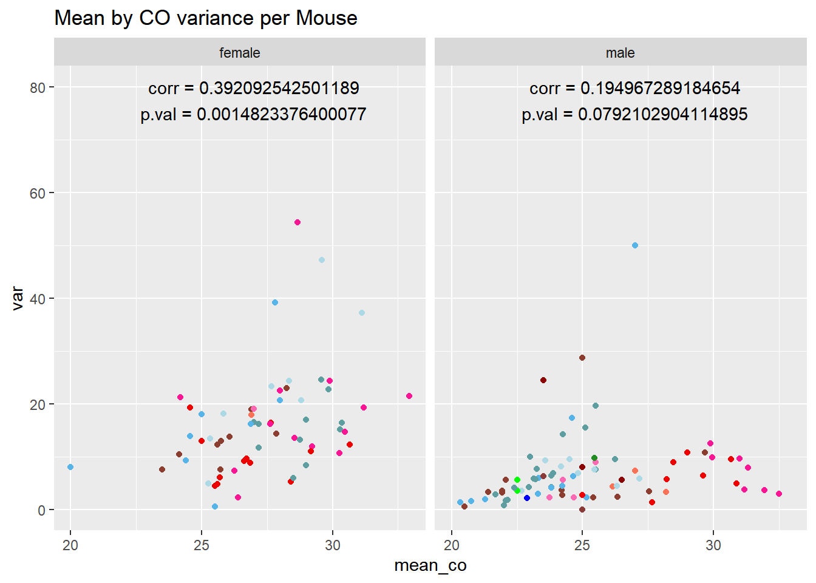
Chapter 3, Correlation of variation and mean recombination rates
Variation in recombination rate
Mean Recombination Rate
Notes:
Between cell variance not influenced by mean in males, (mouse level and strain average)

